Slide 1
Embedded systems
Unit-5
ESRTOS

Slide 2
Tasks and Task States
Task: A task is a basic unit or atomic unit of execution that can be scheduled by an RTOS to use the system resources like CPU , Memory, I/O devices etc.
It starts with reading of the input data and of the internal state of the task, and terminates with the production of the results and updating the internal state.

Slide 3
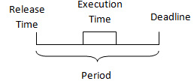
Continues…..
In RTOS, The application is decomposed into small, schedulable, and sequential program units known as “Task”, a basic unit of execution and is governed by three time-critical properties; release time, deadline and execution time.

Slide 4
There are two types of tasks.
(i)Simple Task(S-Task)
(ii) Complex Task(C-Task).

Slide 5
Simple Task (S-task):
A simple task is one which has no synchronization point i. e. , whenever an S-task is started, it continues until its termination point is reached. Because an S-task cannot be blocked within the body of the task the execution time of an S-task is not directly dependent on the progress of the other tasks in the node. S-task is mainly used for single user systems.

Slide 6
Complex Task (C-Task):
A task is called a complex task (C-Task) if it contains a blocking synchronization statement (e. g. , a semaphore operation "wait") within the task body. Such a "wait" operation may be required because the task must wait until a condition outside the task is satisfied, e. g. , until another task has finished updating a common data structure, or until input from a terminal has arrived

Slide 7
Task States
Each task may exist in following states
Dormant : Task doesn’t require computer time
Ready: Task is ready to go active state, waiting processor time
Active: Task is running
Suspended: Task put on hold temporarily
Pending: Task waiting for resource.

Slide 8
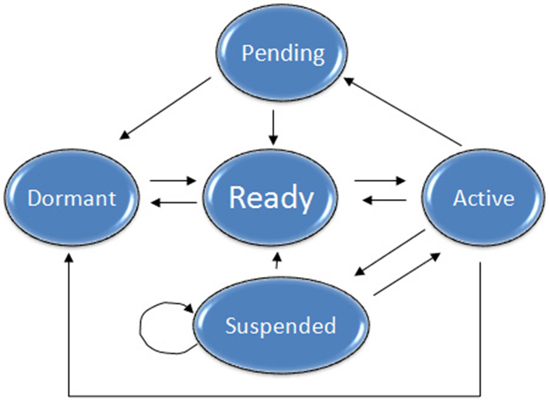

Slide 9
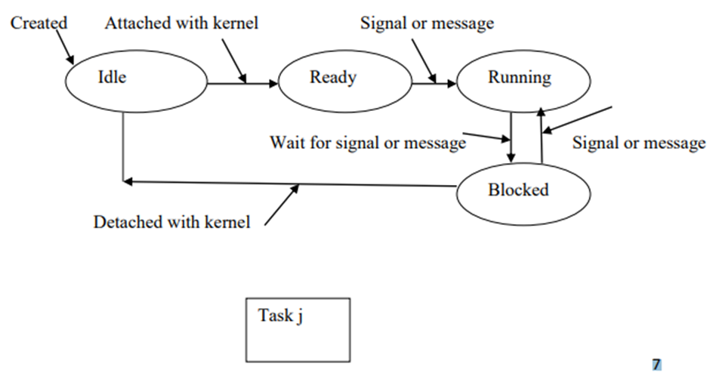

Slide 10
A task object is defined by the following set of components:
Task Control block: Task uses TCBs to remember its context. TCBs are data structures residing in RAM, accessible only by RTOS
Task Stack: These reside in RAM, accessible by stack pointer.
Task Routine: Program code residing in ROM
Task_ID
Task_State
Task_Priority
Task_Stack_Pointer
Task_Prog _Counter

Slide 11
Tasks and Data
Each task has its own context
Which is not shared ,private, registers , stacks
In addition , several tasks share common data via global data declaration; use of “extern” in one task to point another task that declares the shared data
Shared data caused the “shared data problem”

Slide 12
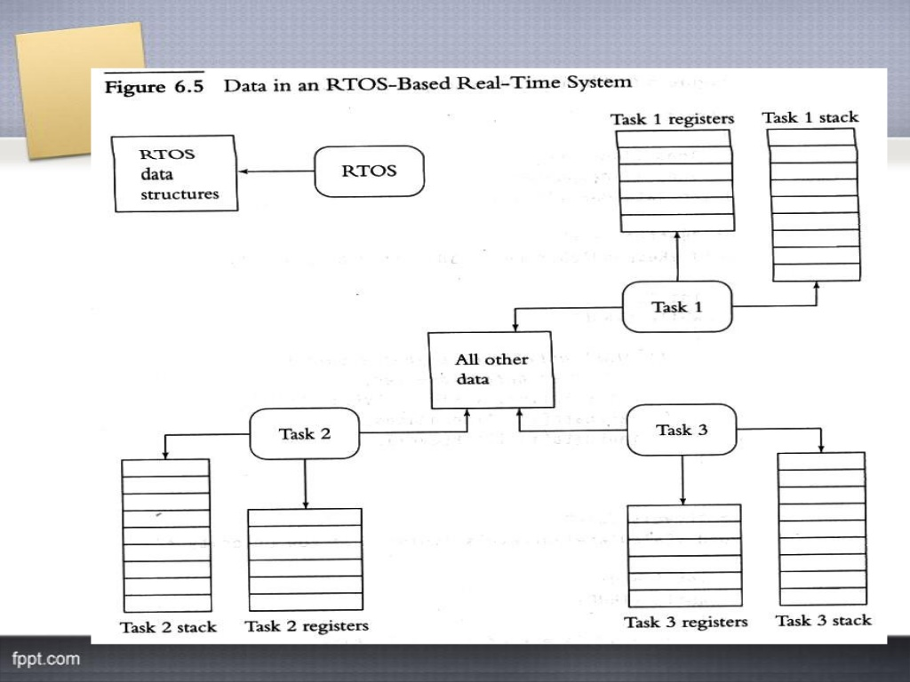

Slide 13
Shared Data Problem
The shared data problem occurs when several functions (or ISRs or tasks) share a variable. Shared data problem can arise in a system when another higher priority task finishes an operation and modifies the data or a variable before the completion of previous task operations.
Reentrancy and further few more topics in this chapter will cover up

Slide 14
THANK YOU
161fa04326
GUNASRI

